Slide 1
Apposcopy: Semantics-Based Detection of Android Malware through Static Analysis

Slide 2
Taint analysis
Pro:
Exposing apps that leak sensitive data in a
sound way.
Cons:
Block legitimate apps.
Notes:
Last week Alex and Brian from team1 taught about Flow Droid. This is a good tool to do taint analysis on Android apps.
They talked about source and sink.
At last of last lecture, they also mentioned that source and sink APIs are collected in certain file to be used, which I‘ll mention later.

Slide 3
Taint analysis
Pro:
Exposing apps that leak sensitive data in a
sound way.
Cons:
Block legitimate apps.
Internet
Notes:
We can get call log, contact list, credit card information as source, do some propagation before use the source data, which we define as sink.
This technique can help to expose every data using point, but it will also block out legitimate app functions like Yelp can get your location information to show restaurants around you, which should not be taken as data leaking.(false positive)

Slide 4
Signature based
Signature based malware detectors:
Certain string values of method or variables.
Pro:
Represent a corpus of malware through finite
signatures.
Detect malware accurately.
Cons:
Update signature frequently;
Obfuscation by bytecode transformation.
Notes:
We can also detect malware through signatures, like this picture, this is gold dream, a sample android Trojan horse which steals information from android devices. This gold dream creates a service called ‘zjService’. definitely we can create a signature based on the string‘zjService'.But it will be really easy to bypass through obfuscation or even just change the string ‘zjService’, and also the signature will change so frequently.

Slide 5
Problem: How to combine advantages of taint analysis and signature based detection?
Apposcopy:
Semantics-Based Detection of Android Malware through Static Analysis
goal: Fewer false positives
Resist common obfuscation
The false positive rate is the proportion of all
negatives that still yield positive test outcomes
The false negative rate is the proportion of
positives which yield negative test outcomes
Notes:
so team from University of Texas at Austin present a way to solve the problem of combining the advantages of taint analysis and signature based detection.
They present Apposcopy, aim to minimize the false positives of taint analysis and resist common obfuscation.
We have a little definition here that false positive is that we have all things negative but there still exist some positive report
and the false positive rate is is the proportion of all negatives that still yield positive test outcomes

Slide 6
Idea from Android Apps
Control flow properties
(Inter-component
communication)
Can Activity A launch Service B?
Data flow properties
(Taint analysis)
Can Receiver C send sensitive data to internet?
Notes:
Now lets come back to android apps, we consider two properties we have. one is control flow property, an example represent this is “can activity a launch service B?”
the other one is data flow property, this is “can receiver c send my credit card information to internet?” this data flow character has already exist in taint analysis techniqe.

Slide 7
Idea from Android Apps
Control flow properties
(Inter-component
communication)
Can Activity A launch Service B?
Our signature should reflect
the Inter-component communication.
Data flow properties
(Taint analysis)
Can Receiver C send sensitive data to internet?
Notes:
So our signature to identify android malwares should reflect the inter component communication property of these malwares.

Slide 8
Idea from Android Apps
Control flow properties
(Inter-component
communication)
Can Activity A launch Service B?
Malware spec Language to create signature
Data flow properties
(Taint analysis)
Can Receiver C send sensitive data to internet?
Notes:
In this paper, they create a malware spec language to create signature.

Slide 9
Apposcopy
Overview
Notes:
They overview of apposcopy is this.
First we need to create signature of malwares, then input app to detect if it is a malware based on the known malware signature.

Slide 10
Apposcopy
Overview
15 families
Control flow properties
Data flow properties
Notes:
They overview of apposcopy is this.
First we need to create signature of malwares, then input app to detect if it is a malware based on the known malware signature.
The author has write 15 families’ signature in the paper, not a huge number to work around.

Slide 11
Apposcopy
Overview
Automated Synthesis of Semantic Malware Signatures using Maximum Satisfiability.
Yu Feng, Osbert Bastani, Ruben Martins, Isil Dillig, Saswat Anand. NDSS 2017.
Notes:
but it is till hard to create signatures, so this team with Stanford university create a system called MaxSAT to automatedly generate malware signature.
this reach out a paper called this, but it is not contained in our presentation.

Slide 12
Example
Notes:
Now, we can look into the Apposcopy through an example.
Still the gold dream

Slide 13
Example
Notes:
first we do taint analysis on this malware, look into the red Rounded Rectangle. there are 4 pairs of source and sink shown over there

Slide 14
Example
Notes:
On the right side is the simplified signature example.
I know its abrupt to show this without any explanation, but I will show the detail of it in a few minutes.
Because after showing you all the steps of this example, you will know what each step’s purpose is, and then I will explain the theory.
its easy to read right over there right, the flow get source of devicedid and sink it into Internet.
this is called flow predicate.
This is the data flow property of this malware.

Slide 15
Example
ICCG: Inter-Component Call Graph, a high level abstraction of android apps
Control-flow properties matching through ICCG construction
Intent Analysis: Resolve the target component
Data Type, Action…
Component A
Component B
Notes:
The next one is Inter-Component Call Graph, this is a high level abstraction of android apps,
which represent apps’ control flow property
And intent analysis is what we have to analysis here, like component A input Type A, Action and other information to Component B to do something, this is like a call graph.

Slide 16
Example
ICCG: Inter-Component Call Graph, a high level abstraction of android apps
Control-flow properties matching through ICCG construction
Intent Analysis: Resolve the target component
Data Type, Action…
Component A
Component B
Notes:
like in this gold dream app. a simplified ICCG is shown above, Lets look into the rounded rectangle.

Slide 17
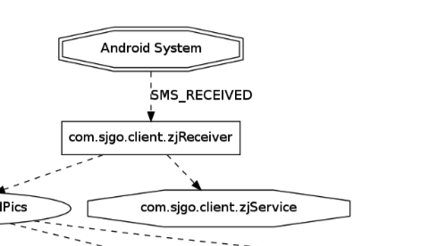
Example
3. component predicate
4. ICC predicate
Notes:
the third line is component predicate
the fourth line is ICC predicate
this is the signature build in predicate ability, means the zjReceiver receive something and send it into Service.
This is the control flow property
Based on all these features, the signature will work nicely without putting to much false positive.
Then I’ll give the definitions of these predications and how the malware spec language come out.
All of the following things seems like math rather than computer science.

Slide 18
Look into Malware SPEC Language
Datalog Preliminaries
Apposcopy Build-in Predicate
Conponent Type Predicate
Predicate ICC
df1
df2
df3
ex1
df4
predicate calls
predicate flows
df5
df6
df7
ex2

Slide 19
Static Analysis
Pointer Analysis & Call-graph Construction
Inter-component Control-flow Analysis
Data flow analysis for Intents
ex3
ICCG construction
ex4
Taint Analysis
Annotations
ex5
Static Taint Analysis
ex6

Slide 20
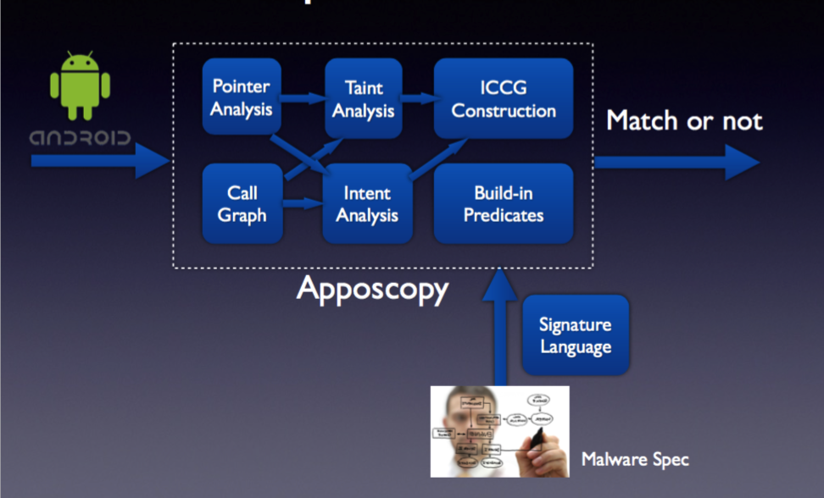
Apposcopy
Implementation
Notes:
Finally, we get the implementation of Apposcopy like this.
it contains pointer analysis, taint analysis, intent analysis. It analyze Inter component graph, call graph and also have a build in predicate logic based on its malware spec language

